Slide 1
Chapter 4
Integrity, Views, Security, and Catalogs

Slide 2
Integrity, Views, Security, and Catalogs
4.1 Integrity Constraints
4.2 Creating Views
4.3 Security: The Grant Statement in SQL
4.4 System Catalogs and Schemas

Slide 3
Integrity, Views, Security, and Catalogs
Introduction
  The DBA must begin by creating the tables and constraints and loading the data. Impose integrity constraints on the columns.
  Then provide views of the data, virtually restructuring the physical tables into variant table forms, to simplify access to data.
  Provide security, so that only authorized users are able to read or update certain confidential data.
  The structure of the various tables, views, and other objects of a database are made available to the DBA through a set of system-defined tables, called system catalogs.

Slide 4
4.1 Integrity Constraints
数据完整性
  保证数据完整性（主要指数据的正确性与一致性）是DBA的最重要任务之一。
  可以通过限制(Constraint)、规则(Rule)和默认(Default)保证数据的完整性，也可以在应用程序层保证数据完整性（这是应用程序设计的问题），或通过存储过程和触发器保证。

Slide 5
4.1 Integrity Constraints
数据完整性的类型
  数据完整性类型包括：实体完整性、参照完整性和用户定义完整性
    实体完整性(Entity Integrity) ：现实世界的实体是可区分的，即它们具有某种唯一性标识。相应地，关系模型中主键应作为唯一性标识。因此实体完整性规则规定基本关系的所有主键(Primary Key)都不能取空值(NULL) 。

Slide 6
4.1 Integrity Constraints
数据完整性的类型
  数据完整性类型包括：实体完整性、参照完整性和用户定义完整性
    参照完整性（Referential Integrity） ：参照完整性维护表与表之间的相关性，通常用“主键(Primary Key)/外键(Foreign Key)”保证，其中Foreign Key可以取NULL值，或取其参照表中Primary Key的取值。

Slide 7
4.1 Integrity Constraints
数据完整性的类型
  数据完整性类型包括：实体完整性、参照完整性和用户定义完整性
    用户定义的完整性(User_defined Integrity )：针对某一具体数据的约束条件，由应用环境决定。例如：某个属性必须取惟一值(UNIQUE)、某个非主属性不能取NULL值、某个属性的取值范围在0～100之间(CHECK)等。

Slide 8
4.1 Integrity Constraints
保证数据完整性
  声明性数据完整性
  声明性数据完整性用限制(Constraint)、规则(Rule)和默认(Default)在数据库中提供保证，这是保证完整性的较好方法。它驻留在数据库内，编程简单，开销小，能更集中管理和保证数据的一致性。
  过程性数据完整性
  过程性数据完整性用存储过程、触发器和应用程序代码保证，通常较为复杂、开销较大，但可以执行更多的业务规则。
  通常，过程性数据完整性是声明性数据完整性的补充
Notes:
后者更复杂，能支撑更复杂逻辑的业务需求（但是应用层面的完整性依旧无法保证，这是后续介绍transaction的主要原因）

Slide 9
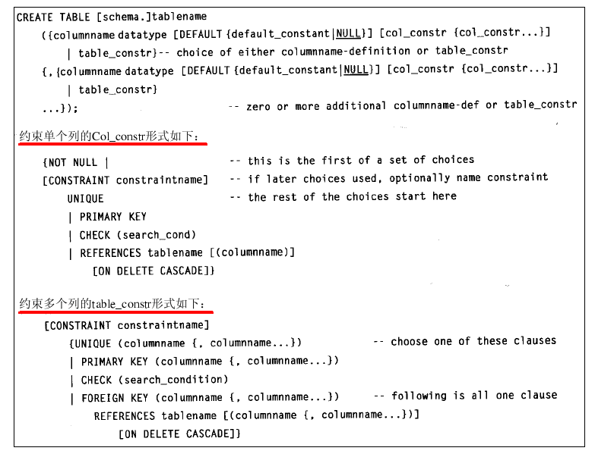
5.1 Integrity Constraints
Definition 5.1.1 Clauses of the Create Table Command.
  图5 - 1的Create Table命令先要给表命名，包括表名和可选的模式名。如果模式名没有给出，将缺省地把执行 Create Table命令的用户名作为模式名。表名之后的圆括号中是用逗号分隔的列定义或表约束的序列。列定义和表约束可以以任何顺序出现。每个列定义包括列的名字、数据类型和可选的 DEFAULT子句。当SQL的Insert语句没有给出该列的值时，就用这个子句的缺省值。

Slide 10
4.1 Integrity Constraints
Definition 4.1.1 Clauses of the Create Table Command.
  上图中的Create Table命令先要给表命名，包括表名和可选的模式名。如果模式名没有给出，将缺省地把执行 Create Table命令的用户名作为模式名。表名之后的圆括号中是用逗号分隔的列定义或表约束的序列。列定义和表约束可以以任何顺序出现。每个列定义包括列的名字、数据类型和可选的 DEFAULT子句。当SQL的Insert语句没有给出该列的值时，就用这个子句的缺省值。

Slide 11
4.1 Integrity Constraints
Definition 4.1.2 Column Constraint
  NOT NULL －If NOT NULL appears in a col_constr, then the DEFAULT clause cannot specify NULL;
  CONSTRAINT－allows us to specify a name for each constraint other than NOT NULL, so that we can later drop the constraint with an ALTER Table statement.
  UNIQUE－ It can be specified even if NOT NULL is not, and the column is then constrained so that all non-null values in the table are unique, but multiple nulls can exist for this column.

Slide 12
4.1 Integrity Constraints
Definition 7.1.2 Column Constraint
  PRIMARY KEY －A column with the PRIMARY KEY column constraint is implicitly defined to be NOT NULL and UNIQUE. The UNIQUE clause and PRIMARY KEY clause cannot both be used for a column, although the PRIMARY KEY clause and the NOT NULL clause can be used together.
  CHECK －each row is constrained to contain a value in this column that satisfies the specified search_condition.

Slide 13
4.1 Integrity Constraints
Definition 7.1.2 Column Constraint
  REFERENCES －The optional ON DELETE CASCADE clause that followed the REFERENCES clause requires that when a row in the referenced table is deleted that is referenced by rows in the referencing table, then those rows in the referencing table are deleted.
    If no ON DELETE clause appears, then such a delete of a referenced row will simply fail to execute.
    ON DELETE RESTRICT

Slide 14
4.1 Integrity Constraints
Def.4.1.2 Column Constraints
  NOT NULL vs. DEFAULT NULL
  Constraint name
    optional
    we can later drop the constraint with an ALTER TABLE command
  UNIQUE vs. NOT NULL
    candidate key: UNIQUE and NOT NULL
Integrity,Views,Security,and Catalogs

Slide 15
4.1 Integrity Constraints
Def.4.1.2 Column Constraints (cont.)
  PRIMARY KEY vs. NOT NULL
  REFERENCES
    FOREIGN KEY vs. PRIMARY KEY
    Values of foreign key
    CASCADE | RESTRICT | SET NULL
  CHECK
Integrity,Views,Security,and Catalogs

Slide 16
4.1 Integrity Constraints
可定义为
Primary Key
Definition 4.1.2 Column Constraint
  use cap;
  create table customers2(cid char(4) not null unique,
  cname varchar(13),
  city varchar(13),
  discnt real constraint discnt_max check (discnt<=15.0)
  );
定义限制名
该限制可以应用于不同的数据表中，且同一数据库中的限制不能同名
alter table customers2
add constraint pk_cust primary key (cid);

Slide 17
4.1 Integrity Constraints
Definition 4.1.3 Table Constraint
  UNIQUE －It is possible to specify a set of columns that must be unique in combination.
  PRIMARY KEY －Specify a non-empty set of columns to be a primary key. Every column that participates in PRIMARY KEY clause is implicitly defined to be NOT NULL.
  CHECK
  FOREIGN KEY… REFERENCES…[ON DELETE [CASCADE]]

Slide 18
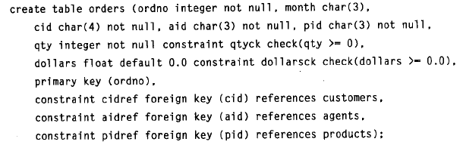
4.1 Integrity Constraints
Definition 4.1.3 Table Constraint

Slide 19
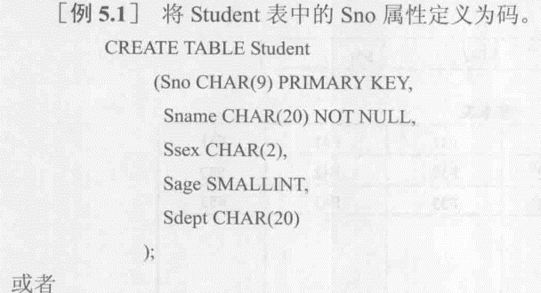
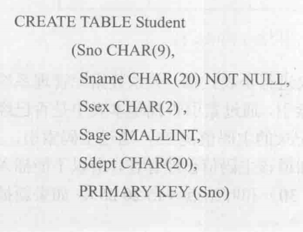
4.1 Integrity Constraints
Definition 4.1.3 Table Constraint

Slide 20
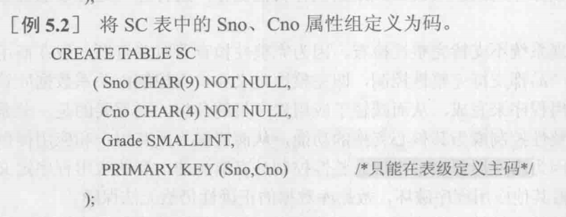
4.1 Integrity Constraints
Entity integrity

Slide 21
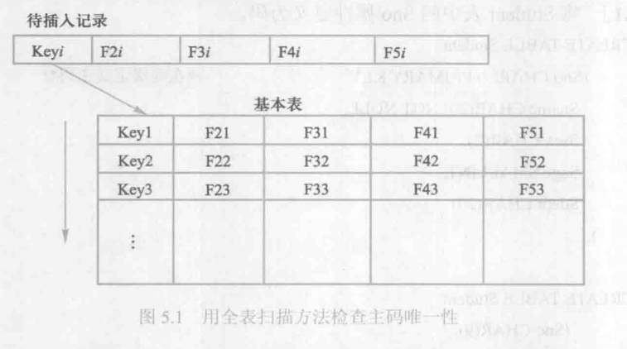
4.1 Integrity Constraints
Entity integrity
  检查主码是否唯一，如果不唯一，则拒绝插入或修改。
  检查主码的各个属性是否为空，只要有一个为空，就拒绝插入或修改。
全表扫描

Slide 22
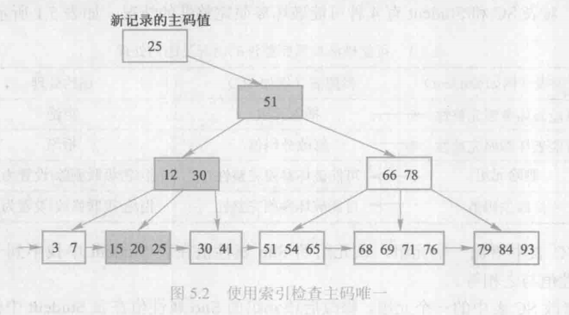
4.1 Integrity Constraints
Entity integrity
  检查主码是否唯一，如果不唯一，则拒绝插入或修改。
  检查主码的各个属性是否为空，只要有一个为空，就拒绝插入或修改。
在主码上建立B+树索引
Notes:
教学手法：
引导学生思考-如果PK上的列不允许重复，新插入一条记录时，必须确保PK取值唯一；此时需要浏览所有已经存在的元组，如何浏览？
答：如果是顺序浏览，当元组N很大时，效率低下。
改进：在PK上建立索引（加快检索命中的速度）

Slide 23
4.1 Integrity Constraints
Primary Keys, Foreign Keys, and Referential Integrity
  Definition 4.1.4 Foreign Key, Referential Integrity. 如果表T1中任意行的F值的组合，至少包含一个空值或与被引用表T2中为候选键或主键的列集合 P的组合值匹配，则列集合 F被定义为外键。换句话说，如果表T1的每一行中F的列都满足
  （1）至少有一列为空值（如果该列允许为空）
  （2）如果不包含空值，就必须与表 T2中某行的相应P的组合值相等，则参照完整性约束是有效的

Slide 24
4.1 Integrity Constraints
Primary Keys, Foreign Keys, and Referential Integrity
ordno | month | cid | ......
1011 | jan | c001 | ......
1019 | feb | c001 | ......
1017 | feb | c001 | ......
1023 | mar | c001 | ......
1022 | mar | c001 | ......
1013 | jan | c002 | ......
1026 | may | c002 | ......
1015 | jan | c003 | ......
1014 | jan | c003 | ......
1021 | feb | c004 | ......
1016 | jan | c006 | ......
1020 | feb | c006 | ......
1024 | mar | c006 | ......
Primary key
Foreign key
cid | cname | city | discnt
c001 | ... | ... | ...
c002 | ... | ... | ...
c003 | ... | ... | ...
c004 | ... | ... | ...
c005 | ... | ... | ...
c006 | ... | ... | ...
Integrity,Views,Security,and Catalogs

Slide 25
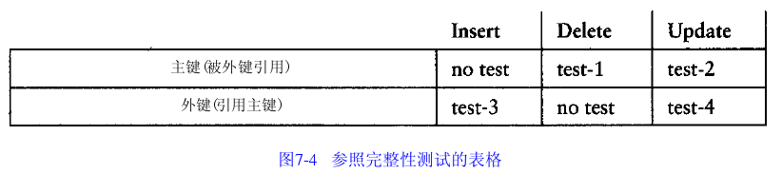
4.1 Integrity Constraints
Primary Keys, Foreign Keys, and Referential Integrity

Slide 26
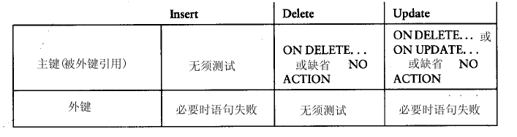
4.1 Integrity Constraints
Primary Keys, Foreign Keys, and Referential Integrity

Slide 27

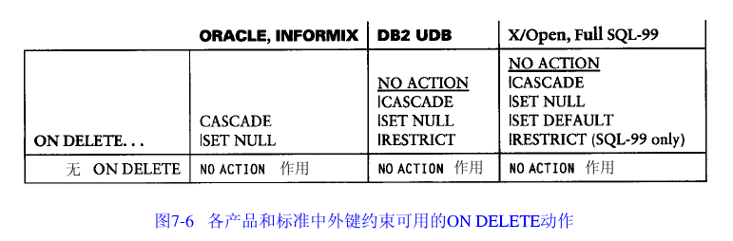
4.1 Integrity Constraints
Foreign Key Constraints: Product variations

Slide 28
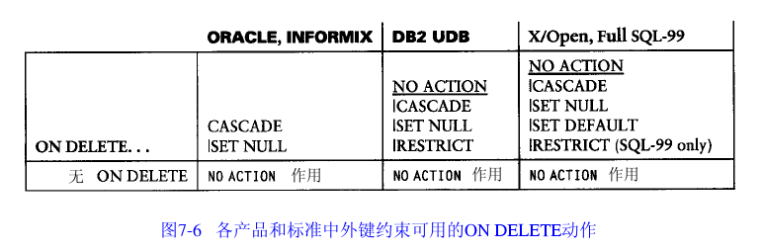
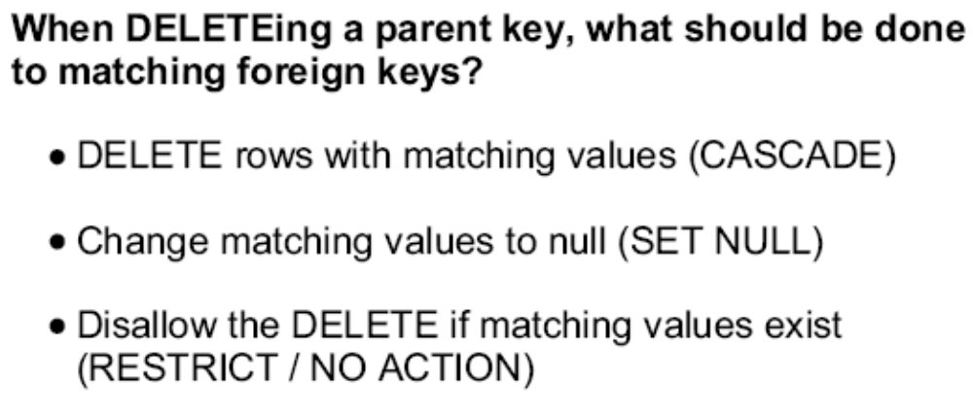
4.1 Integrity Constraints
Foreign Key Constraints: Product variations

Slide 29
4.1 Integrity Constraints
Referential Integrity
  use cap;
  create table sales (sid int identity(1,1),
  cid char(4) references customers2(cid) on delete cascade,
  pid char(4) references products2(pid) on update cascade,
  dollars real constraint dollars_min check (dollars>0.0)
  );
主键表为customers
可定义为customers(cid)
定义限制名
该限制可以应用于不同的数据表中，且同一数据库中的限制不能同名

Slide 30
4.1 Integrity Constraints
Definition 5.1.2 Column Constraint
  use cap;
  insert into sales(cid,pid,dollars)
  select cid,pid,sum(dollars)
  from orders
  group by cid,pid
  order by cid,pid
使用子查询向表中插入数据
测试: delete from sales where cid=‘c001’ and pid=‘p01’
delete from customers2 where cid=‘c001’

Slide 31
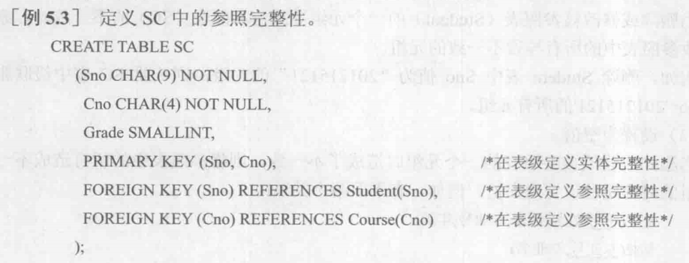
4.1 Integrity Constraints
Referential Integrity

Slide 32
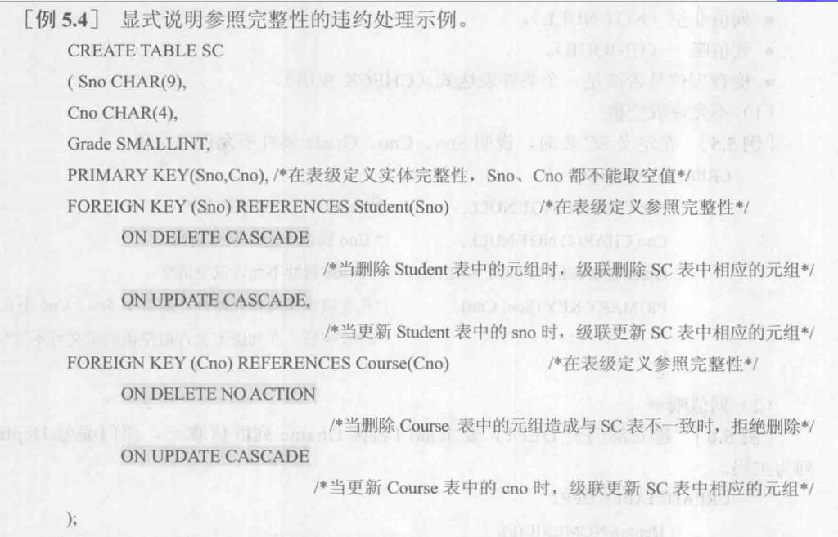
4.1 Integrity Constraints
Referential Integrity

Slide 33
4.1 Integrity Constraints
Example
  primary key: red character
  foreign key: underline
EMPLOYEE ( fname, lname, ssn, address, salary,
        superssn, dno )
DEPARTMENT ( dname, dno, ssn, mgrstartdate )
DEPT_LOCATION ( dno, dcity )
PROJECT ( pname, pno, pcity, dno )
WORKS_ON ( ssn, pno, hours )
DEPENDENT(ssn, dependent-first-name, sex, bdate,
        relationship)
Integrity,Views,Security,and Catalogs

Slide 34
Example of foreign key
EMPLOYEE:
  Emp ( fname, lname, ssn, address, salary, superssn, dno )
DEPARTMENT:
  Dept ( dname, dno, ssn, mgrstartdate )
  CREATE TABLE Dept (
    dno char(4) PRIMARY KEY, ……);
  CREATE TABLE Emp (
    ssn char(8) PRIMARY KEY,
    dno char(4) REFERENCES Dept,
    ……);
在对Emp表进行数据的增、删、改操作时，保证外键dno的引用完整性。
Integrity,Views,Security,and Catalogs

Slide 35
Example of foreign key
但在对Dept表进行数据的增、删、改操作时，不能保证Emp表中外键dno的正确性—早期数据库。
  CREATE TABLE Emp (
    ssn char(8) PRIMARY KEY,
    dno char(4) REFERENCES Dept,
    ……);
  CREATE TABLE Emp (
    ssn char(8) PRIMARY KEY,
    dno char(4)
    REFERENCES Dept ON DELETE RESTRICT,
    ……);
如果某部门中有职工，那么将不允许在Dept表中删除该部门元组，从而保证了Emp表中外键dno的引用完整性。
Integrity,Views,Security,and Catalogs

Slide 36
Example of foreign key
  CREATE TABLE Emp (
    ssn char(8) PRIMARY KEY,
    dno char(4) REFERENCES Dept,
    ……);
  CREATE TABLE Emp (
    ssn char(8) PRIMARY KEY,
    dno char(4)
    REFERENCES Dept ON DELETE CASCADE,
    ……);
如果某部门中有职工，那么在Dept表中删除该部门元组的同时，将从Emp表中删除该部门的所有职工。
Integrity,Views,Security,and Catalogs

Slide 37
Example of foreign key
  CREATE TABLE Emp (
    ssn char(8) PRIMARY KEY,
    dno char(4) REFERENCES Dept,
    ……);
  CREATE TABLE Emp (
    ssn char(8) PRIMARY KEY,
    dno char(4)
    REFERENCES Dept ON DELETE SET NULL,
    ……);
如果某部门中有职工，那么在Dept表中删除该部门元组的同时，在Emp表中将该部门所有职工的dno置为NULL。
Integrity,Views,Security,and Catalogs

Slide 38
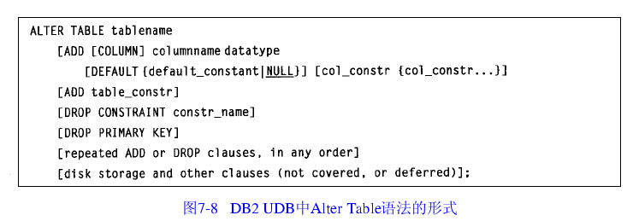
4.1 Integrity Constraints
The Alter Table Statement

Slide 39
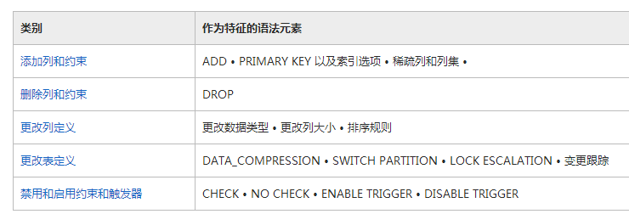
4.1 Integrity Constraints
The Alter Table Statement(SQL Server)
Integrity,Views,Security,and Catalogs

Slide 40
4.1 Integrity Constraints
The Alter Table Statement
Use cap;
Alter Table sales
Add Constraint PK_sid primary Key (sid),
Constraint Ck_dollars_max Check (dollars<=1000.00)

Slide 41
4.1 Integrity Constraints
约束(Constraint)
  约束是保证数据完整性的主要方法，约束类型有Primary Key、Foreign Key、Unique、Check和Default，其中Default可以作为约束，也可以作为数据库中的对象。
  Alter Table Employee
  Add Constraint emp_dept_FK Foreign Key (dno)
  References department(dno)
  ON DELETE CASCADE
  ON UPDATE CASCADE

Slide 42
SQL Language－数据完整性
Constraint
  Check：
  Create Table inventory
  ( item_code char(4) NOT NULL constraint CK_inventory_item_code Check (item_code like ‘[0-9][0-9][0-9][0-9]’),
  high_volume int NOT NULL constraint CK_inventory_high_volume Check (high_volume>0),
  low_volume int NOT NULL constraint CK_inventory_low_volume Check (low_volume>0),
  Constraint CK_inventory_hi_lo_check
  Check (high_volume>=low_volume and
  hign_volume-low_volume<1000)
  )
Demo: SQL & EM

Slide 43
SQL Language－数据完整性
管理限制
  管理限制包括收集限制信息、关闭与重新启用限制、删除限制。
  收集限制信息：可以查询信息结构图，也可以在查询分析器中调用系统存储过程Sp_help和Sp_helpconstraint收集信息。
  关闭与重新启用限制：可以关闭Check与Foreign Key限制，使之不检查现有数据或装入的新数据。
    在现有的表中添加限制时，如果只对新数据加限制，不检查已有数据，则采用With NOCHECK
    Alter Table Products
    WITH NOCHECK
    ADD Constraint CK_Price Check (Price>0)

Slide 44
SQL Language－数据完整性
管理限制
  关闭与重新启用限制：可以关闭Check与Foreign Key限制，使之不检查现有数据或装入的新数据。
    如果要关闭已有限制，对加入新数据不用限制，则采用NOCHECK
    Alter Table Products
    NOCHECK
    Constraint CK_Price
临时关闭约束：alter table tableName NOCHECK constraint 约束名
重新打开约束：alter table tableName CHECK constraint 约束名
查看约束是否打开：EXEC sp_helpconstraint tableName

Slide 45
SQL Language－数据完整性
管理限制
  删除限制：可以用Alter Table 命令删除限制，也可以在企业管理器的设计表选项中删除
  Alter Table Products
  Drop Constraint CK_Price
Notes:
必须有独立名字的约束（对象）才可以用语句删除。

Slide 46
4.1 Integrity Constraints——Triggers
Non-Procedural and Procedural Integrity Constraints: Triggers
  The SQL integrity clauses is non-procedural constraint.
  The procedural integrity, known as triggers.
  We claim that non-procedural constraint miss a good deal of power that is available if constraints can be procedurally specified. However, there is a trade-off in complexity of representation that we need to pay for this added power.

Slide 47
4.1 Integrity Constraints
Non-Procedural and Procedural Integrity Constraints: Triggers
  Procedural Constraint and Triggers
    If the trigger is fired, the optional search_condition, if present, is executed to determine if the current row or set of rows affected should cause further execution.
    If so, the triggered action, given by a single statement or a sequence of statements in a statement block between BEGIN ATOMIC and END, is executed.

Slide 48
4.1 Integrity Constraints
Non-Procedural and Procedural Integrity Constraints: Triggers
  Procedural Constraint and Triggers
    We have an optional REFERENCING clause defining one or more “correlation names” for the affected row or for the whole table.
    Table correlation names can be used with either granularity, but row correlation names can be used only for the granularity FOR EACH ROW.

Slide 49
4.1 Integrity Constraints
Trigger (Figure 7.10, pg. 425) (触发器)
CREATE TRIGGER trigger_name { BEFORE|AFTER }
  { INSERT | DELETE | UPDATE [ OF colname { , colname ... } ] }
  ON table_name
  [ REFERENCING corr_name_def { , ...... } ]
  [ FOR EACH ROW | FOR EACH STATEMENT ]
    [ WHEN ( search_condition ) ]
    { statement
    | BEGIN ATOMIC statement; { ... } END
Integrity,Views,Security,and Catalogs

Slide 50
4.1 Integrity Constraints
The corr_name_def that defines a correlation name follows:
  { OLD [ ROW ] [ AS ] old_row_corr_name
    | NEW [ ROW ] [ AS ] new_row_corr_name
    | OLD TABLE [ AS ] old_table_corr_name
    | NEW TABLE [ AS ] new_table_corr_name }
Integrity,Views,Security,and Catalogs

Slide 51
4.1 Integrity Constraints
Example 4.1.5
  Use a trigger to CHECK that the discnt value of a new customers row does not exceed 15.0.
create trigger discnt_max after insert on customers
  referencing new as x
  for each row when ( x.discnt > 15.0 )
    begin
      raise_application_error(-20003, “invalid discount attempted on insert”);
    end;
Integrity,Views,Security,and Catalogs

Slide 52
4.1 Integrity Constraints
Example 4.1.6
  Use a trigger to change foreign key value.
create trigger foreign_cid after delete on customers
  referencing old as old_custom
  for each row
    begin
      update orders
        set cid = null
        where cid = :old_custom.cid ;
    end;
Integrity,Views,Security,and Catalogs

Slide 53
4.1 Integrity Constraints
SQL Server 中的触发器
  格式：
  Create TRIGGER [ schema_name .]trigger_name
  ON {table_name | view_name}
  [ WITH ENCRYPTION ]
  AFTER | For | Instead of {Insert | Update | Delete}
  AS
  SQL statement
注意：视图只能被INSTEAD OF 触发器引用
对于表或视图，每个 INSERT、UPDATE 或 DELETE 语
句最多可定义一个 INSTEAD OF 触发器。
缺省为FOR，等同于AFTER

Slide 54
4.1 Integrity Constraints
SQL Server 中的触发器
  例1：在pubs数据库中生成一个触发器，打印一条消息，表示update语句更新的数据行数。
  Create TRIGGER tr_au_upd ON authors
  AFTER UPDATE
  as
  Print ‘Trigger Output: ’ + convert(Varchar(5),@@rowcount) + ‘ rows were updated. ’
  go
返回受上一语句影响的行数，当没有行受影响时，返回值为0

Slide 55
4.1 Integrity Constraints
inserted表与deleted表
语句 | inserted内容 | deleted内容
Insert | 增加的行 | 空
Update | 新行 | 旧行
Delete | 空 | 删除的行

Slide 56
4.1 Integrity Constraints
Example 4.1.5(SQL SERVER)
  Use a trigger to CHECK that the discnt value of a new customers row does not exceed 15.0.
create trigger discnt_max on customers
  For insert
  As
  If (exists (select * from inserted where discnt>15))
  begin
raisError(‘invalid discount attempted on insert ', 16, 11);
rollback tran;
end;
Integrity,Views,Security,and Catalogs

Slide 57
4.1 Integrity Constraints
Example 4.1.6(SQL SERVER)
  Use a trigger to change foreign key value.
create trigger foreign_cid on customers
  after delete
  As
      update orders
        set cid = null
        where cid in (select cid from deleted) ;

Slide 58
4.1 Integrity Constraints
inserted表与deleted表
  ON DELETE SET NULL
  create trigger foreigncid
  on customers after delete
  as
  declare @cno char(4);
  select @cno=cid from deleted;
  update orders set cid = null where cid=@cno;

Slide 59
4.1 Integrity Constraints
inserted表与deleted表
  Create Trigger tr_ins_upd ON titles_copy
  Instead of Update
  AS
  IF UPDATE(title_id)
  begin
  RAISERROR(‘You can not change the title_id.’,15,1)
  end
  return

Slide 60
4.1 Integrity Constraints
inserted表与deleted表
  use pubs;
  Create Trigger tr_ins_upd ON titles_copy
  after Update
  AS
  IF UPDATE(title_id)
  rollback;
  else commit;
  return
update titles_copy set title='Net Etiquette?'
where title_id='PC9999'
update titles_copy set title_id='PC9998'
where title_id='PC9999'

Slide 61
4.1 Integrity Constraints
instead of运用 (SQL SERVER)
  问题：有个借书系统，每人限借五本，超出的话不能借，如何通过触发器对借书进行限制？
  create trigger tr_books on bookflow
  INSTEAD OF INSERT
  as
  Begin
  if not exists(select a.借书证号
  from (inserted union bookflow ) a
  group by a.借书证号 having count(*)>5)
  insert into bookflow select * from inserted
  else
  print '已满五本!'
  End

Slide 62
4.1 Integrity Constraints
instead of运用 (SQL SERVER)
  问题：如果有人尚有借书，则此人不能被删除，如何用触发器对删除进行限制？
  -防删除触发器,尚有借书的读者不可被删除
  create trigger tri_student on usertb
  INSTEAD OF delete
  as
  Begin
  if not exists(select * from bookflow a inner join deleted b on a.借书证号=b.借书证号)
  delete from usertb where userid in (select userid from deleted)
  else
  print '尚有借书,不能删除!'
  end

Slide 63
4.1 Integrity Constraints
修改触发器(SQL SERVER)
  alter trigger tgr_message
  on student
  after delete
  as raisError('tgr_message触发器被触发', 16, 10);
  --查询已存在的触发器(SQL SERVER)
  select * from sys.triggers;
  select * from sys.objects where type = 'TR';
  --查看创建触发器语句
  exec sp_helptext 'tgr_message';

Slide 64
4.2 Creating Views
View
  设计思想
    The data retrieved by any SQL SELECT statement is in the form of a table.
    We want to use this TABLE in FROM clause of other Select statement.
  Method
    Subquery in the FROM clause (Figure 3.11, pg 117)
    Creating Views
Integrity,Views,Security,and Catalogs

Slide 65
4.2 Creating Views
View Table ( or View )
  Definition
    It is a table that results from a subquery, but which has its own name
      table name & attributes name
    It can be used in most ways as a Base Table created by SQL CREATE TABLE statement
  Property
    no data storage in its own right, just window on data it selects from
    so, it is regarded as a Virtual Table
    Weakness
      limits to View Updates
Integrity,Views,Security,and Catalogs

Slide 66
4.2 Creating Views
Create View statement (Figure 7.13, pg. 434)
CREATE VIEW view_name [ (col_name { , col_name ... } ) ]
    AS subquery
    [ WITH CHECK OPTION ]
  List of column names
    Can leave out list of colnames if
      target list (Select clause) of subquery has colnames that require no qualifiers.
    Need to give names for expressions or for ambiguous colnames.
    Can rename column in any way at all.
Integrity,Views,Security,and Catalogs

Slide 67
4.2 Creating Views
Create View statement (cont.)
  subquery
    Figure 3.14
    no ORDER BY clause
  WITH CHECK OPTION
    will not permit an update or insert through a updatable view if
      the result in rows that would be invisible to the view Subquery.(保证通过该视图insert or update 记录后，还能通过该视图查询到该记录。也就是不允许执行不满足构造视图条件的那些插入或者更新操作)
Nested View definition
  create a view based on other views
Integrity,Views,Security,and Catalogs

Slide 68
4.2 Creating Views
Executing of Create View statement
  The definition of the view is placed in the system catalogs as a distinct object of the database.
  No data is retrieved or stored.
Operations through Views
  query modification
    A query or update statement that accesses a view can be modified.
    So that the modified query or update actually performs access on base tables.
Integrity,Views,Security,and Catalogs

Slide 69
4.2 Creating Views
Privileges on Views
  The user creating the view
    becomes the owner of the view
    is given update privileges on the view
      assume:
        the view is updatable
        the user has the needed update privileges on the base table on which the view is defined.
Integrity,Views,Security,and Catalogs

Slide 70
4.2 Creating Views
Example 4.2.1 Create View
CREATE VIEW agentorders (ordno, month, cid, aid,
    pid, qty, charge, aname, acity, percent)
  AS SELECT o.ordno, o.month, o.cid, o.aid, o.pid,
      o.qty, o.dollars, a.aname, a.city, a.percent
    FROM orders o, agents a
    WHERE o.aid = a.aid;
Example 4.2.2 Query on View
    SELECT sum (charge)
    FROM agentorders
    WHERE acity = 'Toledo';
Integrity,Views,Security,and Catalogs

Slide 71
4.2 Creating Views
Example 4.2.2 (cont.)
  Query Modification
    SELECT sum (charge)
    FROM agentorders
    WHERE acity = 'Toledo';
    SELECT sum(o.dollars)
    FROM orders o, agents a
    WHERE o.aid = a.aid and a.city = 'Toledo';
Integrity,Views,Security,and Catalogs

Slide 72
Example: Agentorders view can be created by following statement.
CREATE VIEW agentorders
  AS SELECT o.ordno, o.month, o.cid, o.aid, o.pid,
      o.qty, o.dollars, a.aname, a.city, a.percent
    FROM orders o, agents a
    WHERE o.aid = a.aid;
Integrity,Views,Security,and Catalogs

Slide 73
4.2 Creating Views
Example 4.2.3
  illegal view definition
CREATE VIEW cacities
  AS SELECT c.city, a.city
    FROM customers c, agents a, orders o
    WHERE c.cid = o.cid and a.aid = o.aid;
  legal view definition
CREATE VIEW cacities ( ccity, acity )
  AS SELECT c.city, a.city
    FROM customers c, agents a, orders o
    WHERE c.cid = o.cid and a.aid = o.aid;
Integrity,Views,Security,and Catalogs

Slide 74
4.2 Creating Views
Exp 4.2.4 Create Views with ‘WITH CHECK OPTION’
  Assume: No CHECK clause on discnt of customers
    CREATE VIEW custs
      AS SELECT *
        FROM customers
        WHERE discnt <= 15.0
        WITH CHECK OPTION;
Now cannot insert/update a row into custs with discnt > 15.0:
    This insert will fails.
insert into custs values(‘c009’, ‘AM’, ‘Kyoto’, 16.0);
Integrity,Views,Security,and Catalogs
Notes:
Update和insert导致产生view本身不能查询的行，则这样的update或insert操作不允许执行

Slide 75
4.2 Creating Views
Consider the update:
  update custs set discnt = discnt + 4.0;
  This update fails for customer c002 on the basis of the values of Figure 2.2
cid
cname
city
discnt
c001
TipTop
Duluth
10.00
c002
Basics
Dallas
12.00
c003
Allied
Dallas
8.00
c004
ACME
Duluth
8.00
c006
ACME
Kyoto
0.00
Note, this insert and update statement can execute on the base table customers.
Integrity,Views,Security,and Catalogs
Notes:
增加板书内容（参考备课资料上对with check option的介绍）

Slide 76
4.2 Creating Views
Example 4.2.5 Nested Views
CREATE VIEW acorders (ordno, month, cid, aid,
    pid, qty, dollars, aname, cname)
  AS SELECT ao.ordno, ao.month, ao.cid, ao.aid,
      ao.pid, ao.qty, ao.charge, ao.aname, c.cname
    FROM agentorders ao, customers c
    WHERE ao.cid = c.cid;
Integrity,Views,Security,and Catalogs

Slide 77
4.2 Creating Views
Listing Defined Views
  In SQL SERVER
    SELECT definition FROM sysobjects a,sys.all_sql_modules b WHERE a.id = b.object_id and name=‘视图名’
    In SQL SERVER
    SELECT TEXT FROM USER_VIEWS WHERE VIEW_NAME ='视图名‘
Dropping Tables and Views（ORACLE）
  When a view table is dropped, no rows are dropped.
DROP { TABLE table_name | VIEW view_name }
    { CASCADE | RESTRICT };
Integrity,Views,Security,and Catalogs

Slide 78
4.2 Creating Views
  In SQL SERVER
  Drop table:删除一个或多个表定义以及这些表的所有数据、索引、触发器、约束和权限规范。
  任何引用已删除表的视图或存储过程都必须使用 DROP VIEW 或 DROP PROCEDURE 显式删除
  不能使用 DROP TABLE 删除被 FOREIGN KEY 约束引用的表。 必须先删除引用 FOREIGN KEY 约束或引用表。 如果要在同一个 DROP TABLE 语句中删除引用表以及包含主键的表，则必须先列出引用表。
Integrity,Views,Security,and Catalogs

Slide 79
4.2 Creating Views
  In SQL SERVER
  删除视图时，将从系统目录中删除视图的定义和有关视图的其他信息。 还将删除视图的所有权限。
  使用 DROP TABLE 删除的表上的任何视图都必须使用 DROP VIEW 显式删除。
  对索引视图执行 DROP VIEW 时，将自动删除视图上的所有索引。 若要显示视图上的所有索引，请使用 sp_helpindex。
  通过视图进行查询时，数据库引擎将进行检查以确保语句中引用的所有数据库对象都存在，这些对象在语句的上下文中有效，以及数据修改语句没有违反任何数据完整性规则。 如果检查失败，将返回错误消息。 如果检查成功，则将操作转换为对基础表的操作。 如果基础表或视图自最初创建视图以来已发生更改，则删除并重新创建视图可能很有用。
Integrity,Views,Security,and Catalogs

Slide 80
4.2 Creating Views
Updatable and Read-Only Views
  The problem
    How do we translate updates on the View into changes on the base tables?
  Figure 4.15
    Restrictions on the Subquery Clause for an Updatable View
Integrity,Views,Security,and Catalogs

Slide 81
4.2 Creating Views
A view table is said to be updatable when the following conditions hold for its Subquery clause.
The FROM clause of the Subquery must contain only a single table, and if that table is a view table it must also be an updatable view table.
Neither the GROUP BY nor HAVING clause is present.
The DISTINCT keyword is not specified.
The WHERE clause does not contain a Subquery that references any table in the FROM clause, directly or indirectly via views.
All result columns of the Subquery are simple column names: no expressions, no column name appears more than once.
Integrity,Views,Security,and Catalogs

Slide 82
4.2 Creating Views
Example 4.2.6, 4.2.7
    CREATE VIEW custs
      AS SELECT *
        FROM customers
        WHERE discnt <= 15.0
        WITH CHECK OPTION;
Integrity,Views,Security,and Catalogs

Slide 83
4.2 Creating Views
Example 4.2.6, 4.2.7
CREATE VIEW colocated
AS select cid, cname, aid, aname, a.city as acity
  from customers c, agents a
  where c.city = a.city;
CREATE VIEW agentsales (aid, totsales)
  AS select aid, sum(dollars)
      from orders
      group by aid;
Integrity,Views,Security,and Catalogs

Slide 84
4.2 Creating Views
Updatable Views in ORACLE
  can update join views if
    join is N-1 (many-to-one), and
    columns of the view contains the primary key of the table on N side
Integrity,Views,Security,and Catalogs

Slide 85
example 4.2.1:
the view contains the primary key of the table on N side (orders)
CREATE VIEW agentorders (ordno, month, cid, aid,
    pid, qty, charge, aname, acity, percent)
AS SELECT o.ordno, o.month, o.cid, o.aid, o.pid,
    o.qty, o.dollars, a.aname, a.city, a.percent
  FROM orders o, agents a
  WHERE o.aid = a.aid;
join is many to one (orders to agents)
Integrity,Views,Security,and Catalogs

Slide 86
example 4.2.1:
CREATE VIEW agentorders (ordno, month, cid, aid,
    pid, qty, charge, aname, acity, percent)
AS SELECT o.ordno, o.month, o.cid, o.aid, o.pid,
    o.qty, o.dollars, a.aname, a.city, a.percent
  FROM orders o, agents a
  WHERE o.aid = a.aid;
we can only update the columns that map one-to-one with the orders table ( on N side )
not the aname, acity, or percent columns ( on 1 side ), and also not the aid column
Integrity,Views,Security,and Catalogs

Slide 87
4.2 Creating Views
  Display updatable column of this view
      select column_name, updatable
      from user_updatable_columns
      where table_name = ‘AGENTORDERS’
Integrity,Views,Security,and Catalogs
Notes:
13987120761

Slide 88
4.2 Creating Views
The Value of Views
  Views provide a way to make complex, commonly issued queries easier to compose.
  Views allow obsolete tables, and programs that reference them, to survive reorganization.
    program-data independence (数据独立性)
  Views add a security aspect to allow different users to see the same data in different ways.
Integrity,Views,Security,and Catalogs

Slide 89
4.3 Database Security
Security
  数据库安全性是指保护数据库以防止不合法使用造成的数据泄露、更改或破坏。
  数据库的不安全因素
    非授权用户对数据库的恶意存取和破坏
    数据库中重要或敏感的数据被泄露
    安全环境的脆弱性
  安全标准
    TCSE 和 CC

Slide 90
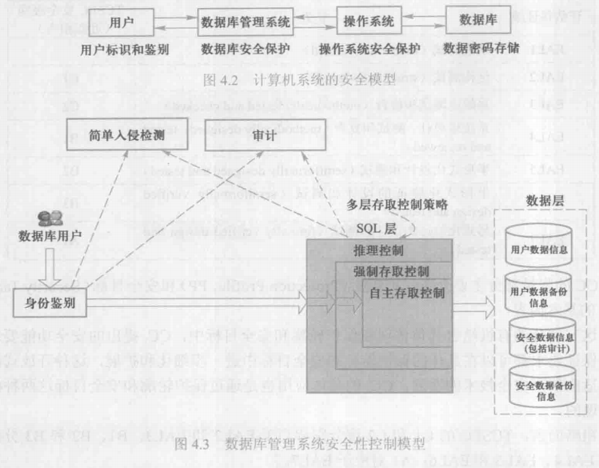
4.3 Database Security

Slide 91
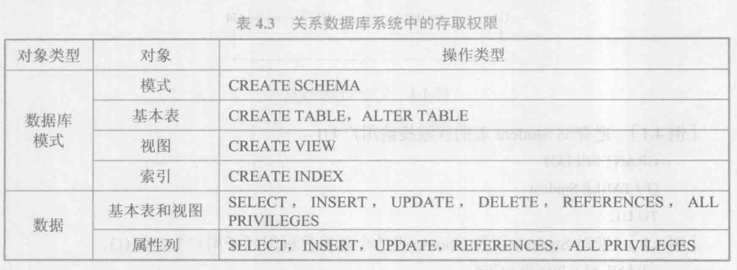
4.3 Security: The Grant Statement in SQL
列权限包括SELECT、REFERENCES、INSERT、UPDATE
Notes:
安全指涉的对象：数据或者对象（显式创建的、具有名称的object）的操纵语句

Slide 92
4.3 Security: The Grant Statement in SQL
Security
  The Grant statement is an SQL command issued by the owner of a table (base table or view table) to authorize various kinds of access (select, update, delete, or insert) to the table by another user or class of users.
  [4.3.1]
  grant select on customers to user1;

Slide 93
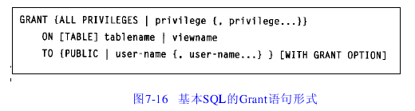
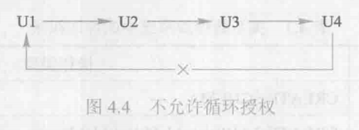
4.3 Security: The Grant Statement in SQL
包括：SELECT, DELETE,
INSERT
UPDATE[(col {,col…})]
REFERENCES[(col {,col…})]
The owner of a table
automatically has all
privileges
用户具有了将得到的权限授予其他用户的权限

Slide 94
4.3 Security: The Grant Statement in SQL
Grant permission to user user1 on the customers table to insert or delete any row, update only the cname and city columns, and select all columns other than discnt column.
  grant delete, insert, update(cname, city) on customers to user1;
  insert into customers values
  ('c007', 'ACME','UK', 10)
  delete from customers where cid='c007'
  update customers set cname='acme' where cid='c007'

Slide 95
4.3 Security: The Grant Statement in SQL
Grant permission to user user1 on the customers table to insert or delete any row, update only the cname and city columns, and select all columns other than discnt column.
  create view custview as select cid, cname, city from customers;
  grant select, delete, insert, update(cname, city) on custview to user1;
  grant insert on customers to user1;

Slide 96
4.3 Security: The Grant Statement in SQL
Grant permission to user user1 to perform all accesses on agents with percent greater thant 5.
  create view agentview as
  select * from agents where percent>4
  grant all privileges on agentview to user1

Slide 97

4.3 Security: The Grant Statement in SQL
Revoke privileges on a table

Slide 98
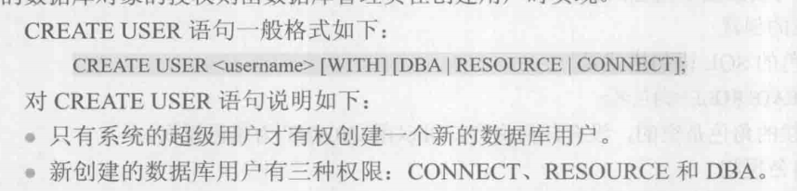
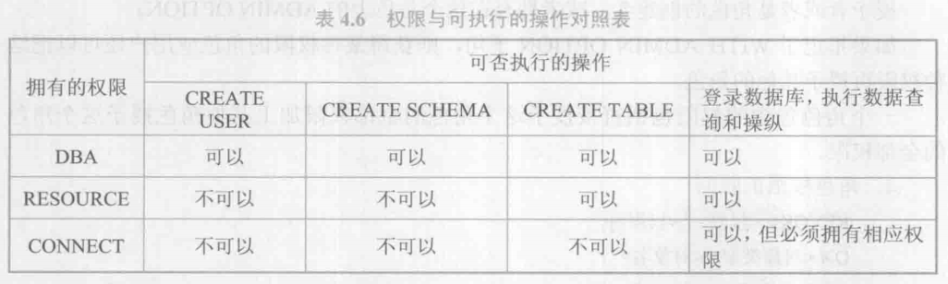
4.3 Security: The Grant Statement in SQL
DBA、RESOURCE与CONNECT

Slide 99
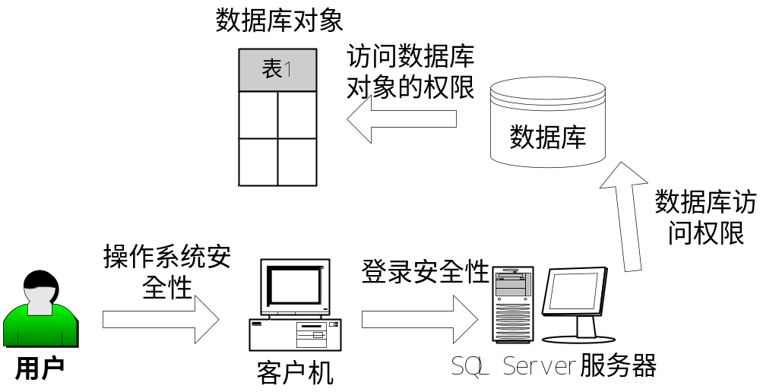
SQL Server的安全性机制
目前，SQL Server的安全性机制主要划分为4个等级
  客户机操作系统的安全性
  SQL Server的登录安全性－登录帐号和密码
  数据库的使用安全性－该用户帐号对数据库的访问权限
  数据库对象的使用安全性－该用户帐号对数据库对象的访问权限

Slide 100
SQL Server的安全性机制
安全模式
  为了SQL Server服务器和数据库的安全，系统管理员应该规划一个高效的安全模式，一个高效的安全模式主要包括以下内容：
    做一些细致的、具有前瞻性的安全规划
    选择安全形式
    配置安全角色
    指定对象以及语句的许可权限

Slide 101
SQL Server的安全性机制
安全模式
  安全规划（在系统开始运行之前完成）
    确定采用何种登录验证方式
    确定登录验证方式后必须把Windows 用户添加到SQL Server系统中
    决定哪些用户将执行管理SQL Server服务器系统的任务，并为这些用户分配适当的服务器角色
    决定哪些用户存取哪些数据库，并为这些用户添加到适当的数据库角色
    给适当的用户或角色授予适当的存取数据库对象的权限，以便用户能够操作相应的数据库对象

Slide 102
SQL Server的安全性机制
安全模式
  选择安全形式（主要指用户登录的验证方式）
    Windows验证方式：完全采用Windows服务器的验证，只要可以登录到Windows的用户，就可以登录到SQL Server数据库系统
    Windows与SQL Server混合验证方式：更灵活，不能登录到Windows的用户，只要是SQL Server的用户就可以登录到数据库系统

Slide 103
SQL Server的安全性机制
安全模式
  配置安全角色
    服务器角色：服务器角色允许登录到SQL Server服务器，并具有操作服务器的权限。
    数据库角色：数据库角色允许对数据库对象进行操作。
    创建用户后，为用户分配适当的角色
  指定对象及语句许可权限
    授予用户对数据库中具体对象的操作权限和对SQL语句的使用权限
    数据库对象（如数据表、视图、存储过程等）
    任何用户都具有对数据表或视图数据的读取（Select）权限，但对于插入（Insert）、更新（Update）和删除（Delete）权限则需要明确授权。

Slide 104
SQL Server安全性－角色
角色是管理SQL Server服务器操作权限和SQL Server数据库访问权限的单位。其成员继承角色所拥有的权限。
  角色类似用户组，设置角色的目的就是为了方便数据库的管理
  角色管理过程：
    创建角色（并非所有角色都能创建）
    将访问许可权限集中授予角色
    将需要拥有这些访问许可权限的用户加入到角色中

Slide 105
SQL Server安全性－角色
固有角色
  固有角色就是SQL Server预先定义好的系统角色，用户不能修改这些角色的任何属性
  服务器角色：（8个固有服务器角色）用户不能删除、不能修改服务器固有角色，也不能创建新的服务器固有角色
    SQL Server服务器只有固有角色，不可以创建新的角色
  数据库角色：（系统为每个数据库设置了10个数据库固有角色）数据库角色在数据库的安全级别上创建，并被某一特定的数据库使用。用户不能修改，也不能删除数据库固有角色。
    用户可以创建新的数据库固有角色
public是一个特殊的数据库角色，每个数据库都具有
这一角色。数据库的所有用户都自动属于public角色，
并且不能从该角色中删除。

Slide 106
SQL Server安全性－角色
创建角色
  创建数据库角色
    角色授权：授予数据库角色访问数据库对象的权限
    可以进行授权的数据库对象主要包括存储过程、系统表、用户定义的数据表、视图等
  创建应用程序角色
    标准数据库角色：既可以在SQL Server中操作数据库，也可以通过应用程序使用数据库
    应用程序角色：仅可以通过应用程序访问数据库
将用户创建的角色添加到固有角色
  添加后，用户定义的新角色就拥有了固有角色原来具有的权限

Slide 107
SQL Server安全性－数据库用户
  使用“登录帐号”登录到SQL Server服务器上之后，用户并不一定能够使用服务器中的具体数据库，要为数据库创建能够使用它的“数据库用户”。
  创建数据库用户：
    选择“登录名”与“用户名”
    为用户选择适当的数据库角色
    为用户授权
      “√”表示授予权限(Grant)
      “×”表示拒绝权限(Deny)
      “□”表示取消权限(Revoke)

Slide 108
SQL Server安全性
从用户的角度看
  系统管理员是具有最高权限的用户（如：默认系统管理员sa，以及System Administrator角色中的所有登录帐号 ）
  登录到SQL Server服务器后，需要设置对数据库的使用权限
  数据库管理员是对某一数据库而言的最高权限拥有者（如：默认数据库管理员dbo，以及db_owner角色中的所有用户）
  授权：
    为登录帐号配置“服务器角色”、“数据库访问”权限
    为数据库用户配置“数据库对象访问权限”

Slide 109
SQL Server安全性－许可
从数据库对象的角度看
  在SQL Server中，具有三种类型的许可：对象许可、数据库许可和固有角色隐含许可
  对象许可：为数据库对象设置可以使用它的用户能够拥有的使用权限
  每个数据库对象都有各自独立的许可保护
语 句 | 所作用的对象
Select | 数据表、视图、列
Insert | 数据表、视图、列
Update | 数据表、视图
Delete | 数据表、视图
Exec | 存储过程

Slide 110
SQL Server安全性－许可
从数据库对象的角度看
  数据库许可：
    指用户创建、修改或删除数据库、数据库对象的操作权限，还包括备份数据库和事务日志的权限。
语 句 | 所作用的对象
Create Default | 在数据库中创建默认对象
Create Procedure | 在数据库中创建存储过程
Create Rule | 在数据库中创建规则
Create Table | 在数据库中创建数据表
Create View | 在数据库中创建视图
Backup Database | 备份数据库
Backup Log | 备份事务日志

Slide 111
SQL Server安全性－许可
从数据库对象的角度看
  固有角色隐含许可：
    服务器固有角色和数据库固有角色都分别被预先授予了适当的权限，称为隐含许可
    对服务器固有角色和数据库固有角色的隐含许可不能删除、也不能修改

Slide 112
4.4 System Catalogs and Schemas
All relational database systems maintain system catalogs, tables (or views) maintained by the system that contain information about objects defined in the database.
Such objects include tables defined with the Create Table, columns, indexes, views, privileges, constrains, and so on.
DB2 UDB refers to catalog tables; X/Open standard to system views

Slide 113
4.4 System Catalogs and Schemas
The catalog tables are created at the time that a database is created
The catalog tables are meant to be updated by the system in response to data definition statements and a few other statement types.
The user is not supposed to update catalog tables directly.

Slide 114
4.4 System Catalogs and Schemas
Schemas
  The full name of a table within a database catalog is schemaname.tablename (where the schemaname is usually a user name).
  This naming system allows different users (such as student in a class) to employ the same talename without ambiguity in the full databse.
  In some database systems, besides a schema for each user, there are additional schemas used, such as schema SYSCAT in DB2 UDB.

Slide 115
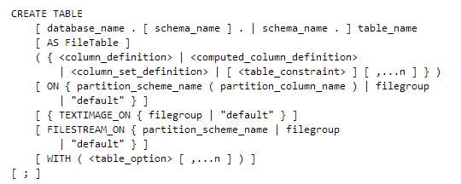
4.1 Integrity Constraints-SQL SERVER 2008

Slide 116
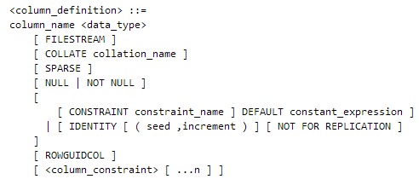
4.1 Integrity Constraints-SQL SERVER 2008
列定义

Slide 117
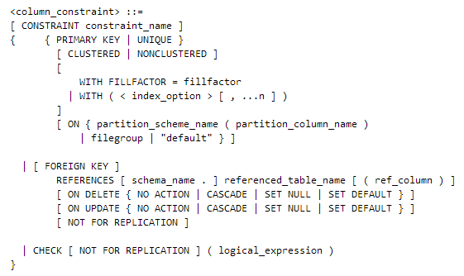
4.1 Integrity Constraints-SQL SERVER 2008

Slide 118
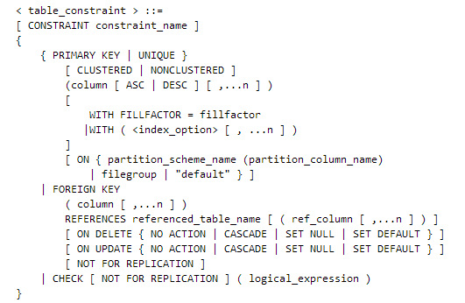
4.1 Integrity Constraints-SQL SERVER 2008

Slide 119
DB2练习
Which of the following delete rules will not allow a row to be deleted from the parent table if a row with the corresponding key value still exits in the child table?
A. DELETE
B. CASCADE
C. RESTRICT
D. SET NULL

Slide 120
DB2练习
Given the following table definition and SQL statement:
Create Table table1(col1 int, col2 char(40), col3 int);
Grant insert, update, select, references on table1 to user usera;
Which of the following SQL statements will revoke privileges for user usera on col1 and col2?
A. Revoke update on table table1 from user usera;
B. Revoke all privileges on table table1 from user usera;
C. Revoke all privileges on table table1 column (col1, col2) from user usera;
D. Revoke references on table table1 column (col1, col2) from user usera;
hejing <number>

Slide 121
DB2练习
Given the statement:
CREATE TABLE t1
( c1 CHAR(3)
CONSTRAINT c1 CHECK (c1 IN ('A01','B01','C01')) )
DB2 verifies that the table check constraint is met during which of the following actions?
A. Reorganizing the table.
B. Updating any row in the table.
C. Adding an insert trigger to the table.
D. Creating a unique index for the table.
hejing <number>

Slide 122
DB2练习
Given the statement:
CREATE VIEW v1 AS SELECT c1 FROM t1 WHERE c1='a'
WITH CHECK OPTION
Which of the following SQL statements will insert data into the table?
A. INSERT INTO v1 VALUES (a)
B. INSERT INTO v1 VALUES (b)
C. INSERT INTO v1 VALUES ('b')
D. INSERT INTO v1 VALUES ('a')
E. INSERT INTO v1 VALUES ('ab')
hejing <number>

Slide 123
DB2练习
Given the following SQL statement:
GRANT REFERENCES ON TABLE tab1 TO USER usera
Which of the following describes what USERA is allowed to do?
A. Create a read-only view using TAB1.
B. Alter TAB1 to add a check constraint.
C. Define a primary key or unique constraint on TAB1.
D. Define a dependent table where TAB1 is the parent.
hejing <number>

Slide 124
DB2练习
Given that the following statements were executed in order:
CREATE TABLE tab1 (c1 CHAR(1))
INSERT INTO tab1 VALUES ('b')
CREATE VIEW view1
AS SELECT c1 FROM tab1 WHERE c1 ='a'
INSERT INTO view1 VALUES ('a')
INSERT INTO view1 VALUES ('b')
How many rows would be returned from the following statement? SELECT c1 FROM tab1
A. 0 B. 1 C. 2 D. 3
hejing <number>

Slide 125
DB2练习
Which of the following will grant just DML operations on table T.T4 to all users?
A. GRANT ALL PRIVILEGES ON t.t4 TO PUBLIC
B. GRANT ALL PRIVILEGES ON t.t4 TO ALL USERS
C. GRANT SELECT, INSERT, UPDATE, DELETE ON TABLE t.t4 to PUBLIC
D. GRANT SELECT, INSERT, UPDATE, DELETE ON TABLE t.t4 TO ALL USERS
hejing <number>

Slide 126
DB2练习
Given a user defined function U.UDF1, that takes an input parameter of type INTEGER, and USER6 running the following SQL statement:
SELECT u.udf1(col6) FROM t.tab1 WHERE col4 = 'ABC'
Which of the following statements would allow USER6 to execute the statement?
A. GRANT ALL PRIVILEGES ON TABLE t.tab1 TO user6
B. GRANT SELECT ON TABLE t.tab1 TO user6
GRANT USE ON FUNCTION u.udf1(INT) TO user6
C. GRANT SELECT ON TABLE t.tab1 TO user6
GRANT REFERENCES ON FUNCTION u.udf1(INT) TO user6
D. GRANT ALL PRIVILEGES ON TABLE t.tab1 TO user6
GRANT EXECUTE ON FUNCTION u.udf1(INT) TO user6
hejing <number>

